Slide 1


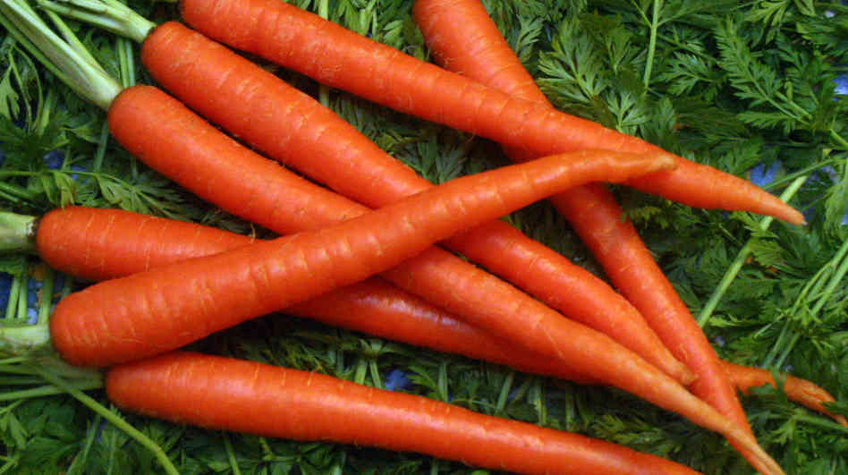

Slide 2
Class – Five Subject-English
Lesson –Seven
Page – 32
Time – 40 Minutes

Slide 3


Learning Outcome
Students will be able to
L-understand question asked by the teacher about them.
S-say sentences with proper intonation.
R-Read words,phrases and sentences with proper pronunciation.
W-Write words,phrases and sentences using non-cursive.

Slide 4
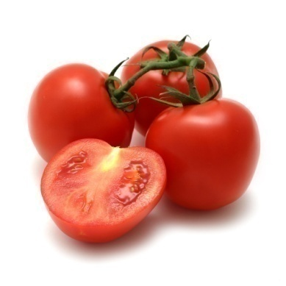
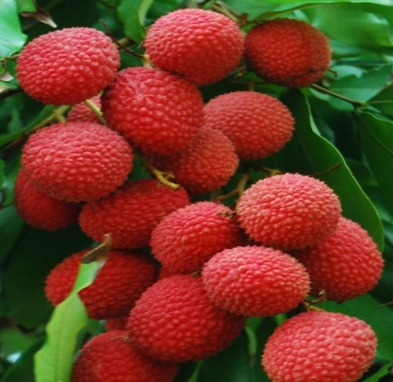

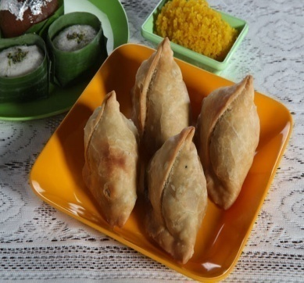

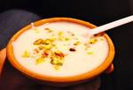
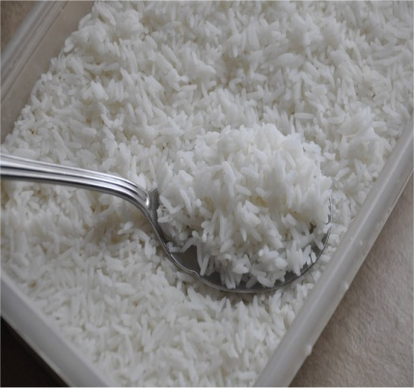

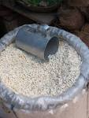

Slide 5
FOOD
(Grouping)

Slide 6



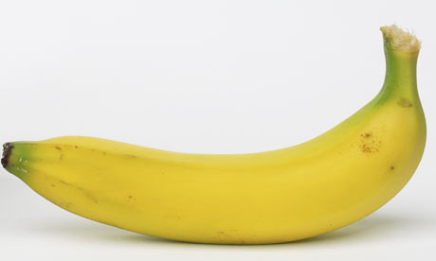
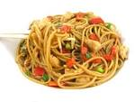
tomato
lichi
pumpkin
singara
banana
noodles

Slide 7
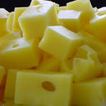
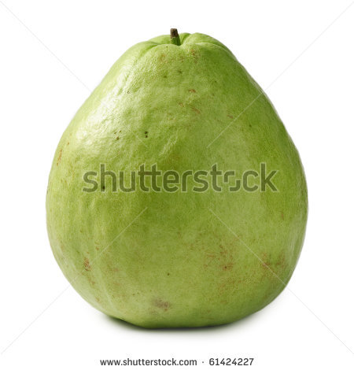
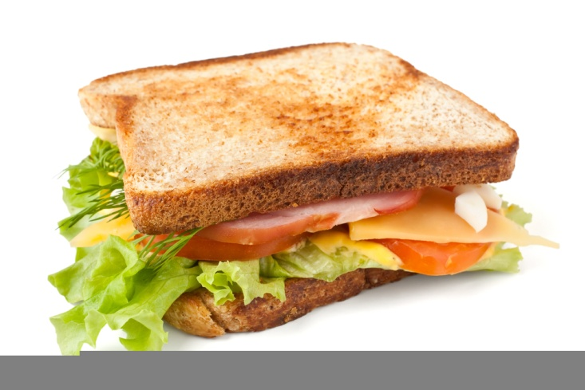
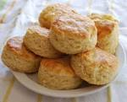
cheese
guava
firni
sandwich
pineapple
biscuits

Slide 8

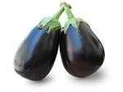



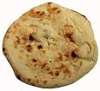
cornflakes
eggplants
orange
yogurt
ruti
cake

Slide 9
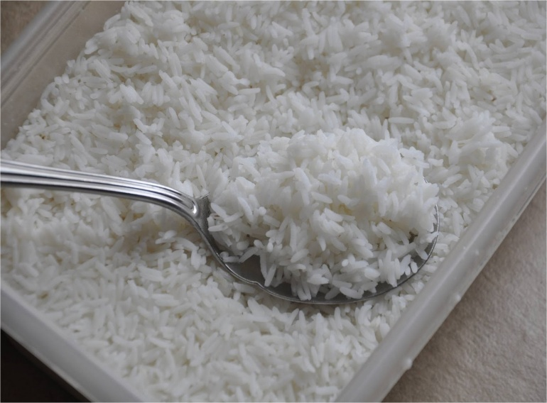
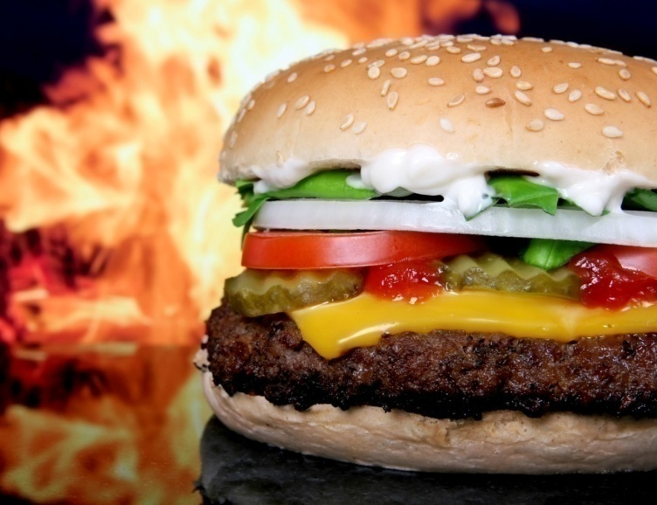
carrots
rice
burger
muri

Slide 10

tomato
eggplants
pumpkin
Vegetables

Slide 11

banana
lichi
orange
Fruits

Slide 12
sandwich
noodles
singara
Snacks

Slide 13
firni
yogurt
cheese
Dairy

Slide 14
rice
muri
Cereals

Slide 15
GROUP WORK
(05 MINUTES)
Group- Vegetable
Group- Fruit
Group- Cereal
Group- Dairy
Group- Snack

Slide 16
tomato
puffed rice
lichi
pumpkin
singara
banana
pudding
noodles
cheese
guava
firni
sandwich
pineapple
biscuits
cornflakes
eggplants
orange
yogurt
roti
cake
carrots
vegetables
fruits
cereals
dairy
snacks

